Slide 1
OAPSA Fall Conference
Sue Zake, Director of OEC September 26, 2014

Slide 2

For too long we’ve been a compliance driven bureaucracy when it comes to educating students with disabilities.” said U.S. Secretary of Education, Arne Duncan. “We have to expect the very best from our students—and tell the truth about student performance—so that we can give all students the supports and services they need. The best way to do that is by focusing on results.” Press Release, March 1, 2012

Slide 3
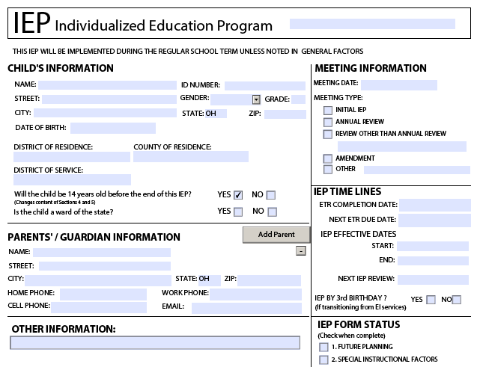

Results Driven Accountability: The Vision
Student Outcomes
Notes:
The vision of RDA is to create a balance between the focus on improved results and functional outcomes for students with disabilities while considering compliance as it relates to those results and outcomes.
Emphasis for federal and state monitoring should be on the requirements most related to improving results.

Slide 4

RDA: Principles
Build capacity at state and local levels
Differentiated support and TA
A siloed approach won’t work

Slide 5
Ohio’s 2014 Results Driven Determination

Slide 6
Ohio’s Determination
Needs
Assistance

Slide 7
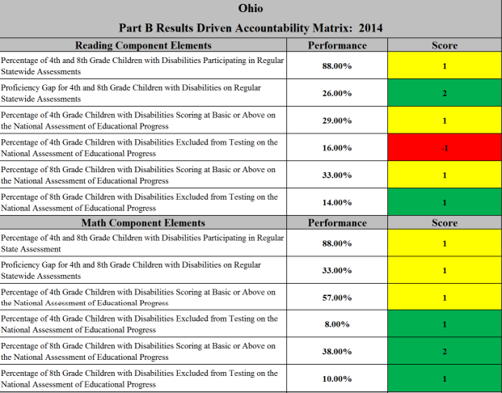
Determinations Calculations
RDA Matrix includes 12 elements for scoring
4 elements based on state assessments
8 elements based on NAEP assessments
Score range: -1 to 2
20 possible points, ≥16
= Meets Requirements
Ohio’s Total = 12

Slide 8
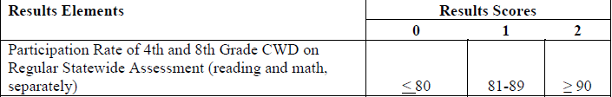
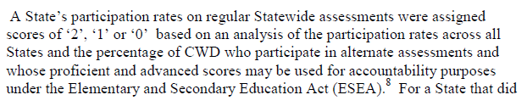
RDA Matrix: Reading

Slide 9
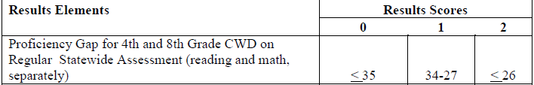

RDA Matrix: Reading

Slide 10


RDA Matrix: Reading

Slide 11

RDA Matrix: Reading

Slide 12

RDA Matrix: Reading

Slide 13
RDA Matrix: Reading

Slide 14
RDA Matrix: Math

Slide 15
RDA Matrix: Math

Slide 16

RDA Matrix: Math

Slide 17
RDA Matrix: Math

Slide 18

RDA Matrix: Math

Slide 19
RDA Matrix: Math

Slide 20
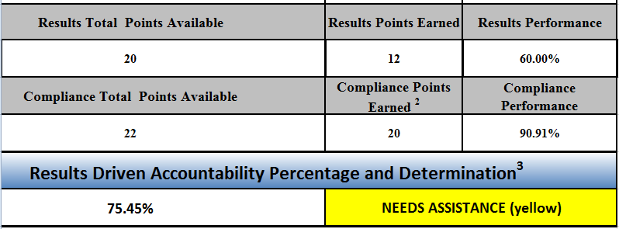
Determination Calculation
*See Compliance Matrix for Ohio’s scores for each compliance indicator.

Slide 21
How We Compare …
Determination | # of States | 7 Pak States (CA, FL, IL, NY, OH, PA, TX,)
Meets Requirements | 18 | 2
Needs Assistance | 36 | 3
Needs Intervention | 6 | 2
Supporting text font: Arial 32

Slide 22
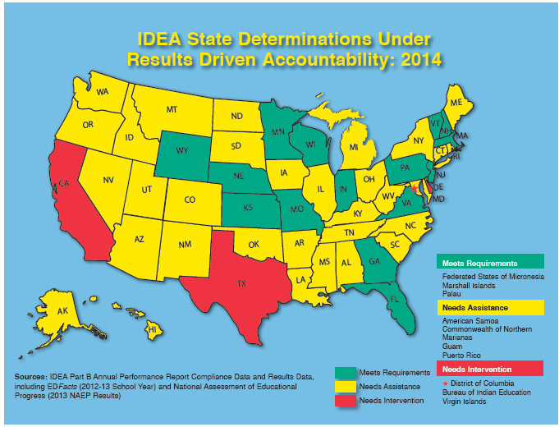
Header Font: Arial 42 Bold
Supporting text font: Arial 32

Slide 23
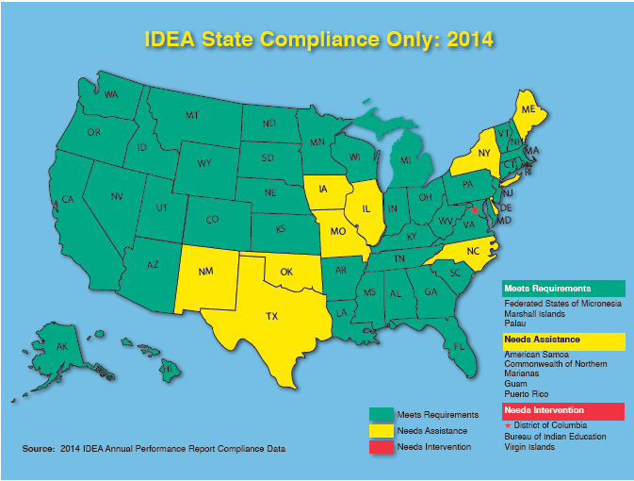
Header Font: Arial 42 Bold
Supporting text font: Arial 32

Slide 24
What it means …
Analysis of elements and indicators -> improvement strategies
Use of National Technical Assistance Centers
Focused Improvement Aligned with the ESEA Waiver

Slide 25
Ohio District Determinations: Now & In the Future

Slide 26
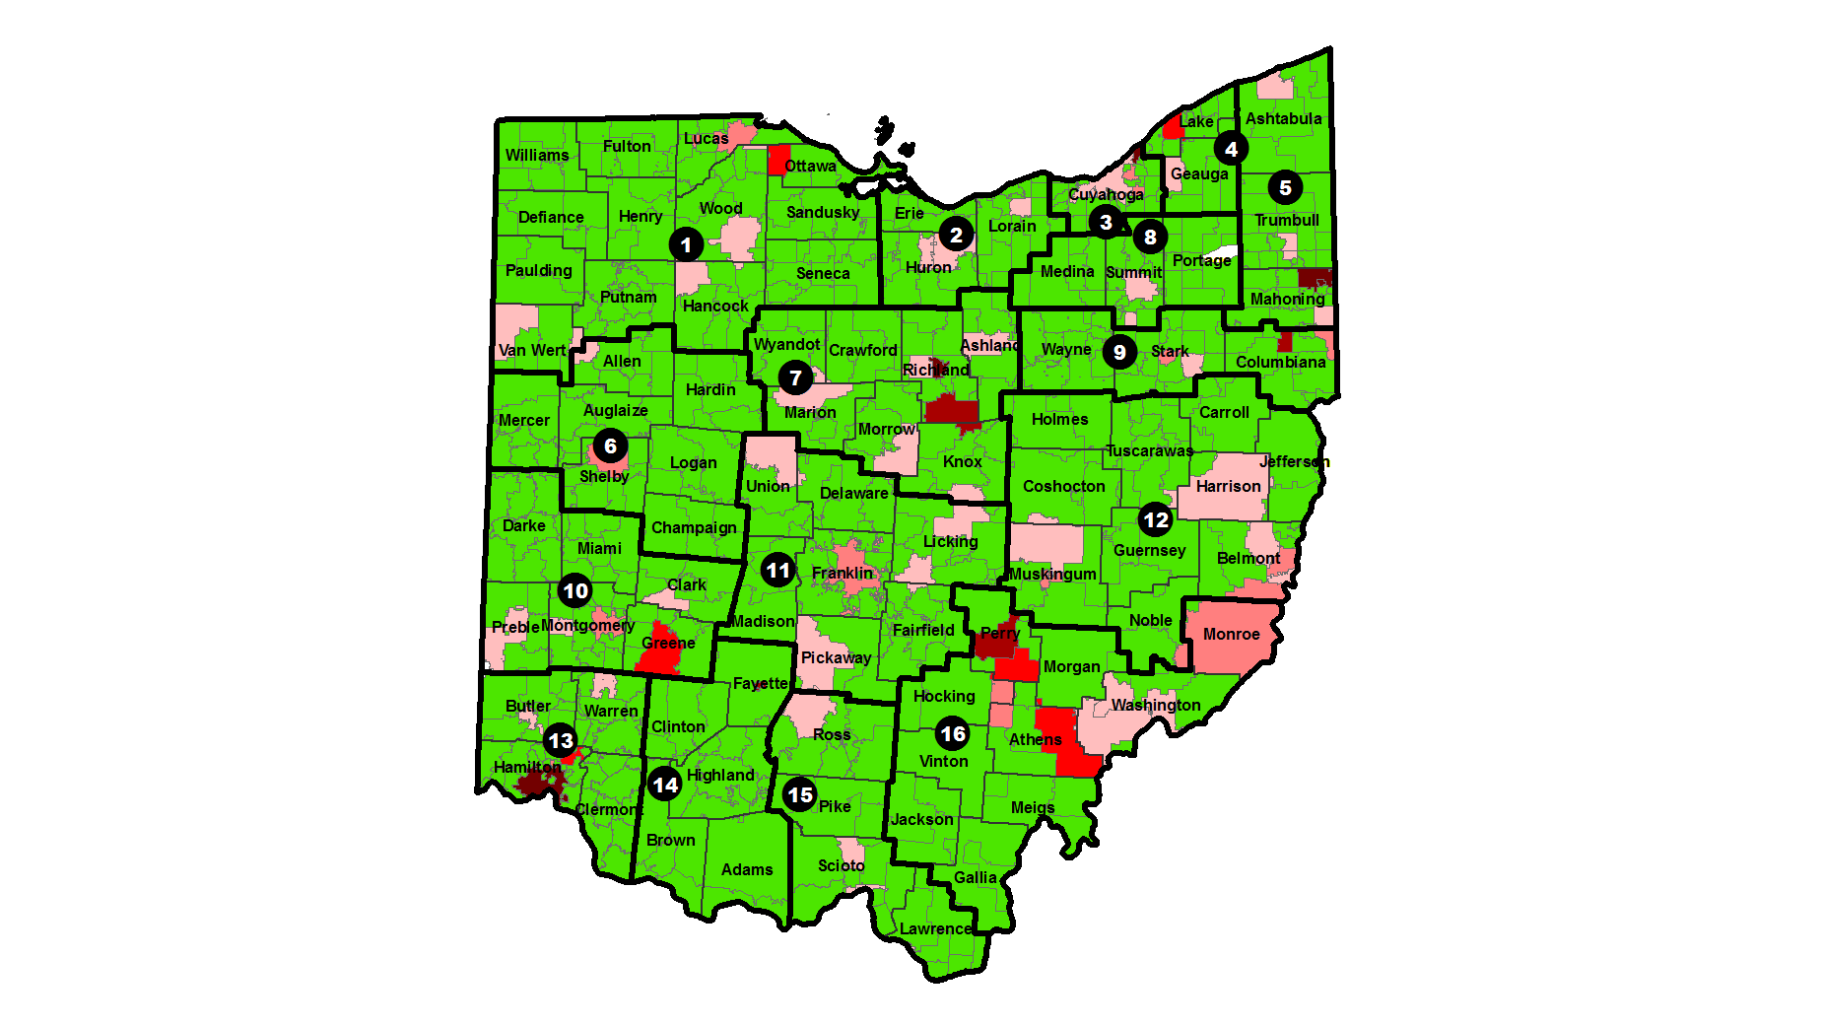
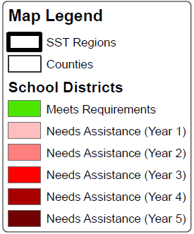
2014 LEA Determinations
Notes:
This map shows the 2014 district determinations, which were based on compliance indicators. Multiple years of “Needs Assistance” tend to reflect systemic noncompliance issues, though not always for the same indicator.
It’s important to note that districts can receive “Meets Requirements” if they are at 95% or above on the compliance indicators.

Slide 27

The Intent
Results Driven – Maximize the use of resources that will result in better academic, social and post-secondary outcomes for students with disabilities
Meet regulatory requirements

Slide 28
Are young children with disabilities entering kindergarten ready to learn?
Are children with disabilities achieving at high levels?
Indicator 3 Statewide Assessment
Indicator 4 Suspension/Expulsion
Are youth with disabilities prepared for life, work and postsecondary education?
Indicator 1 Graduation
Does the state implement IDEA to provide special education and related services for children with disabilities?
Indicator 8 Facilitated Parent Involvement
Indicator 5 School-age Educational Environments
Indicator 2 Dropout
Indicator 13 Secondary Transition
Indicator 14 Postsecondary Outcomes
Indicator 11 Child Find
Indicator 9 Disproportionality (All Categories)
Indicator 6 Preschool Educational Environments
What is the state’s plan for improving results for children with disabilities?
Indicator 17 State Systemic Improvement Plan
Indicator 12 Early Childhood Transition
Indicator 7 Preschool Outcomes
Indicator 10 Disproportionality (Specific Categories)
Indicator 15 Mediations
Indicator 16 Resolution Sessions
Notes:
SAPEC – will be determining new targets for indicators; A workgroup will be asked to assist in reviewing the current process for district determinations and develop a determination process that addresses performance.
With the changes that have been made we will now report on 17 indicators – we prefer to group them in terms of what’s happening for kids.
Though the SSIP is listed as the last indicator, it is really the plan that will drive our work for several years.

Slide 29

State Systemic Improvement Plan: The Purpose
Increase capacity to implement, scale up, and sustain evidence-based practices.
Improve results for children with disabilities (and their families).

Slide 30
SSIP: Activities
Year 1 Delivered by April 2015 | Year 2 Delivered by February 2016 | Years 3-6 Delivered Feb 2017- 2020
Phase I – Analysis | Phase II – Plan | Phase III – Evaluation
Data analysis Infrastructure analysis Focus area Improvement strategies Theory of action | Infrastructure development Support for LEA implementation of EBPs Evaluation | Report progress on SSIP implementation

Slide 31
Ohio’s SSIP: Phase I
Generate Ideas
Prioritize Ideas
Select Focus Area
Identify Strategies
Develop Theory of Action
From your perspective, what strategic focus would yield the most significant improvement in results for children and youth with disabilities in Ohio's state plan for systemic improvement?

Slide 32
State Systemic Improvement Plan
Survey Round One
8/11/14 – 8/29/14
9/10/14: State SSIP Team Meets
Survey Round Two
9/29/14 – 10/13/14
10/23/14: State SSIP Team Meets
10/29/14: SSIP Core Team Meets to identify SIMR
Develop Theory of Action
Identify Improvement Strategies
4/1/15: Submit SSIP

Slide 33
The Federal Agenda
Results in a historically compliance driven IDEA and ESEA system
State and Local Determinations
Results Driven Accountability
College and Career Ready:
Students with Disabilities
English Learners with Disabilities
Universal preschool

Slide 34
UPDATES from OEC
Operating Standards and Guidance
Dispute Resolution
HB 264 – 504 & students with diabetes
Graduation Requirements
Students with Disabilities District and Building Report by October 1, 2015

Slide 35
State Support Teams (SSTs)

Slide 36
SSTs Are Directed by:
The Ohio Department of Education:
Office for Exceptional Children
Office for Improvement and Innovation
Office of Early Learning and School Readiness

Slide 37
Ohio Improvement Process
A Systemic and Systematic Planning
Process Focusing on Adult Behavior and Student Performance
********
Beneficial for ALL
School Districts & Community Schools

Slide 38
The Ohio Improvement Process (OIP)
Build the capacity of districts/schools to engage in inclusive, continuous and sustainable improvement in order to raise student achievement and close the achievement gap

Slide 39
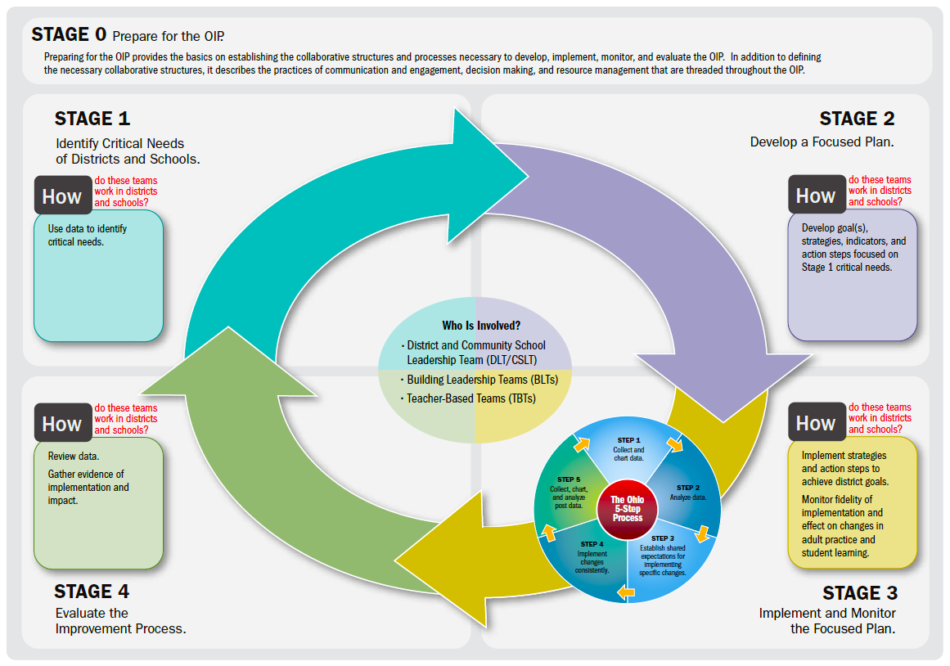

Slide 40

Strategy – Leadership

Slide 41
Differentiated Accountability

Slide 42
Districts and Schools and ESEA Wavier
Districts:
Academic Distress
High Support
Medium Support
Low Support
Independent Support

Slide 43
Districts and Schools and ESEA Wavier
Schools
Priority (A, H, M)
Focus or Alert (A, H, M, L, I)
Improvement (A, H, M, L, I)

Slide 44
Districts and Schools and ESEA Wavier
District and School Requirements are aligned!
Interventions and Support are more prescriptive as student achievement and subgroup gaps move away from benchmarks.

Slide 45

State Support Teams
Performance Agreement
Ohio’s State Support Teams
2014-15

Slide 46
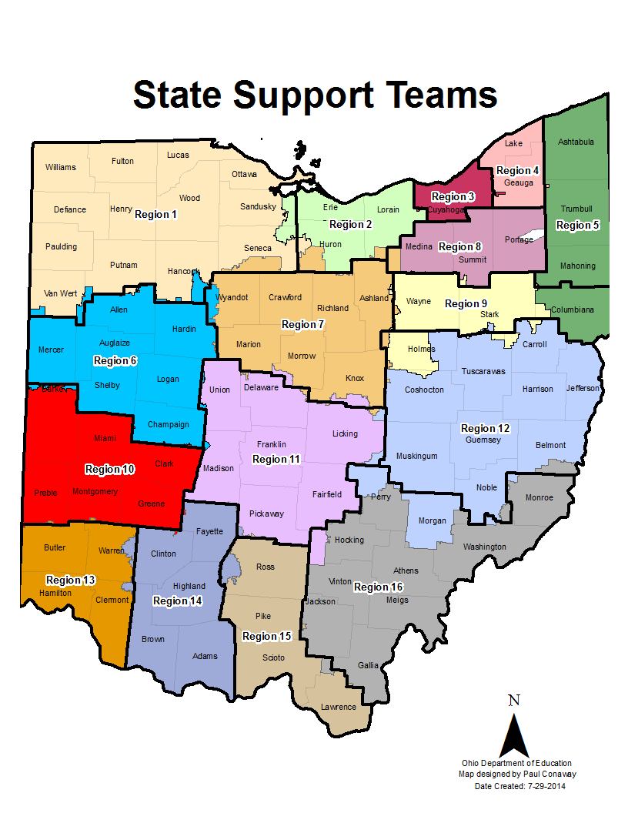

Slide 47
SST
PURPOSE
means of delivering a unified system of support that meaningfully connects research based processes

Slide 48
SST
PURPOSE
… with a focus on improving instructional practice and student performance on an on-going basis

Slide 49
SST
GOAL
build the capacity of local and related education agencies to engage in systemic and sustainable improvement.

Slide 50
Performance Agreement Deliverable #1
Provide differentiated and tiered information, professional development and technical assistance as outlined in the regional CCIP, based on:
the needs of identified districts/programs
prioritized regional needs

Slide 51
Performance Agreement: Deliverable #2
Implement the Ohio Improvement Process (OIP) to focus on improved student outcomes.
Build Capacity
Provide High Quality Technical Assistance and Professional development.
Multi-tiered Systems of Support (MTSS)
Promote collaboration between agencies to meet the needs of all students and their families.

Slide 52
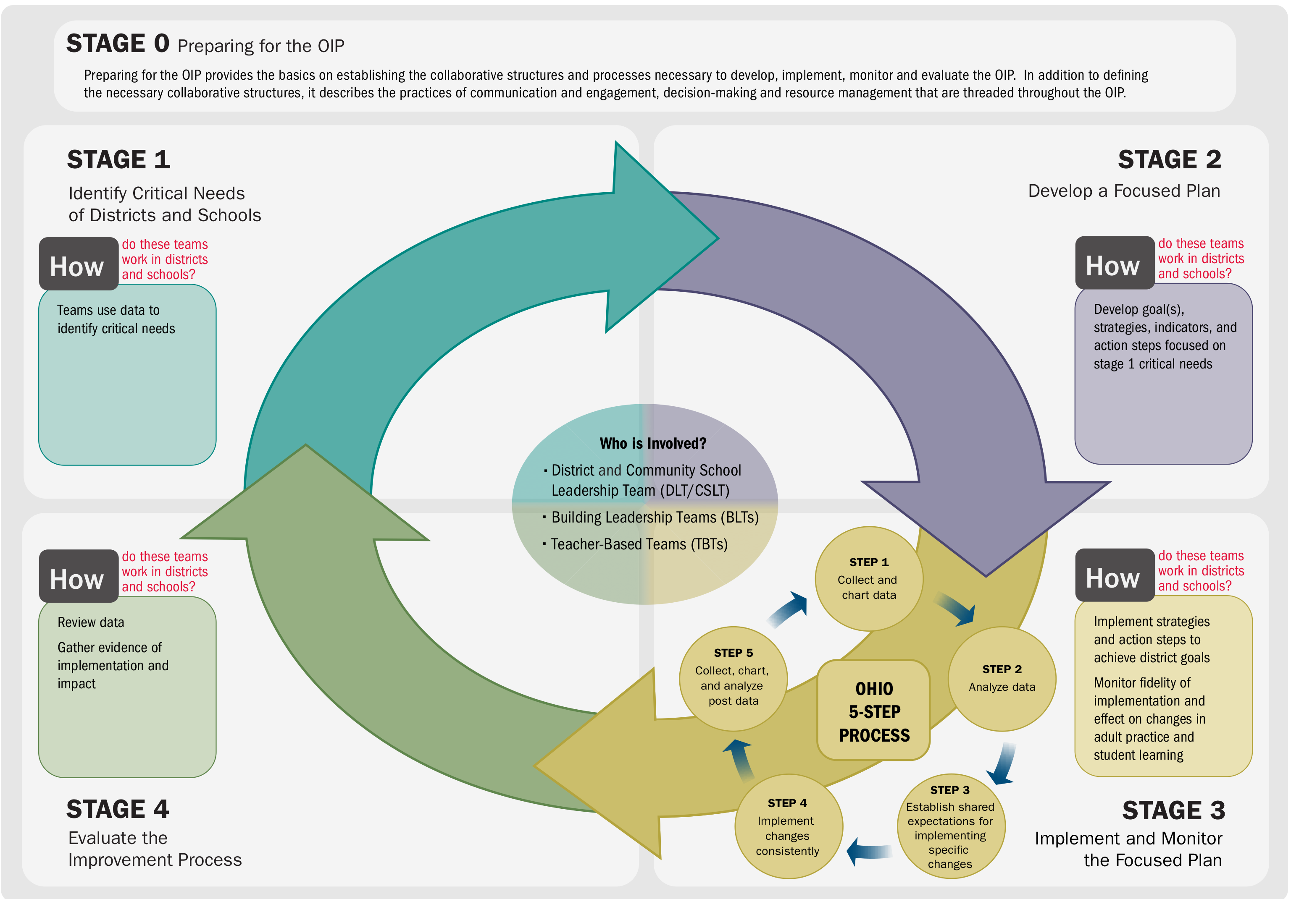
Introduction to Ohio Improvement Process

Slide 53
Performance Agreement: Deliverable #3
Provide approved information regarding Federal and State laws/rules/regulations/guidance/initiatives to educators, parents and community agency representatives in an accessible format.

Slide 54
Performance Agreement: Deliverable #4
Provide high quality professional development and focused technical assistance for implementation of requirements:
Individuals with Disabilities Education Act (IDEA)
Operating Standards for Ohio Educational Agencies Serving Children with Disabilities
Family Educational Rights and Privacy Act (FERPA)
Ohio’s ESEA Flexibility Waiver
Other federal and state laws, rules, regulations, guidance and initiatives to educators, parents and community agency representatives.

Slide 55
State Support Team Panel
Susan Schraff, Assistant Director - Region 3
Becky Rees, Director– Region 6
Jenine Sansosti, Director – Region 8
Brad McFadden, Director – Region 12
Notes:
ODE facilitator - Pam
introduce yourself - describe the work you do – what are your job responsibilities?
Tips for getting started in regional work
Maybe something about differences between regional work and LEA based work
How to gain entrance to a district or approach staff within districts
Hints about designing and delivering PD – how you know the needs, who you work with, …
How TA assistance is provided – differences, if any, between responding to TA/procedural questions as an LEA staff member vs. responding as an SST staff member
How you have addressed barriers and/or resistance
How to sustain the work within an LEA or with a group of educators.

Slide 56

education.ohio.gov

Slide 57





Social Media
Ohio Families and Education
Ohio Teachers’ Homeroom
ohio-department-of-education
storify.com/ohioEdDept
@OHEducation
OhioEdDept

